Slide 1

Computer Basics
CS4MS+ Project
Images Courtesy of Adobe Stock Free

Slide 2
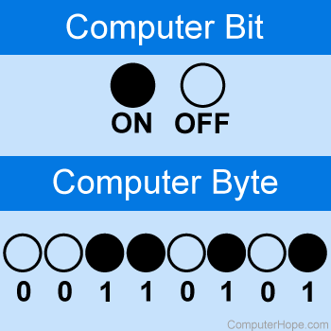

Basic Computer Vocab
Bit - | Smallest measurement of computer data *Measured by a 0 or 1 which is indicated as “on” (1) and “off” (0)
Byte - | Collection of 8 bits, the basic unit of data
Hertz - | Unit used to measure hardware speed * 1 Hertz is one cycle per second
Refresh Rate- | Number of times a new frame/image is shown on screen *A 24Hz TV/monitor displays 24 new images per second. (Really fast slideshow!)

Slide 3
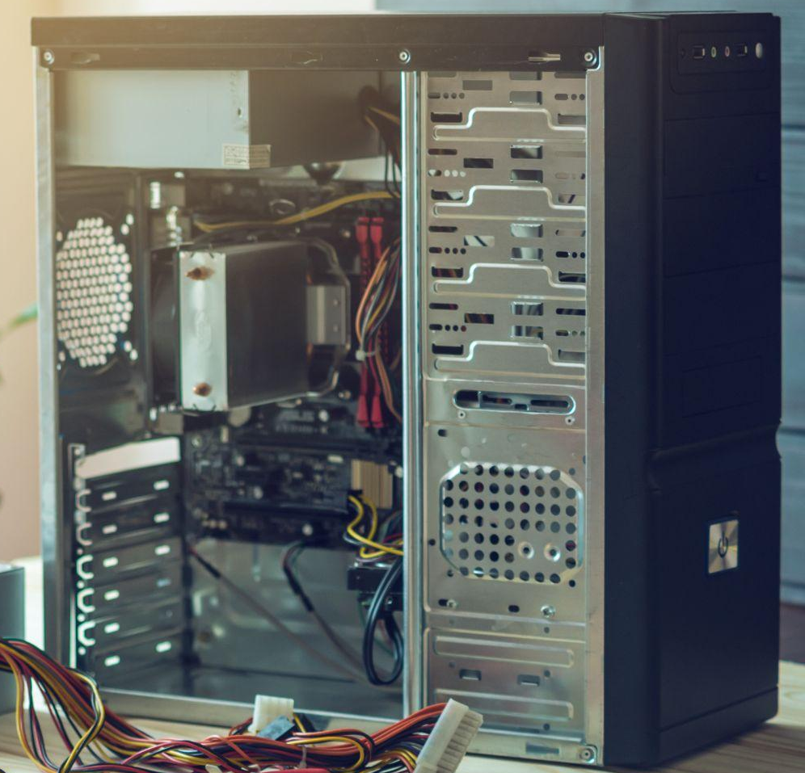
Common Computer Unit Prefixes
Kilo - | One thousand units
Mega - | One million units
Giga - | One billion units
Tera - | One trillion units

Slide 4
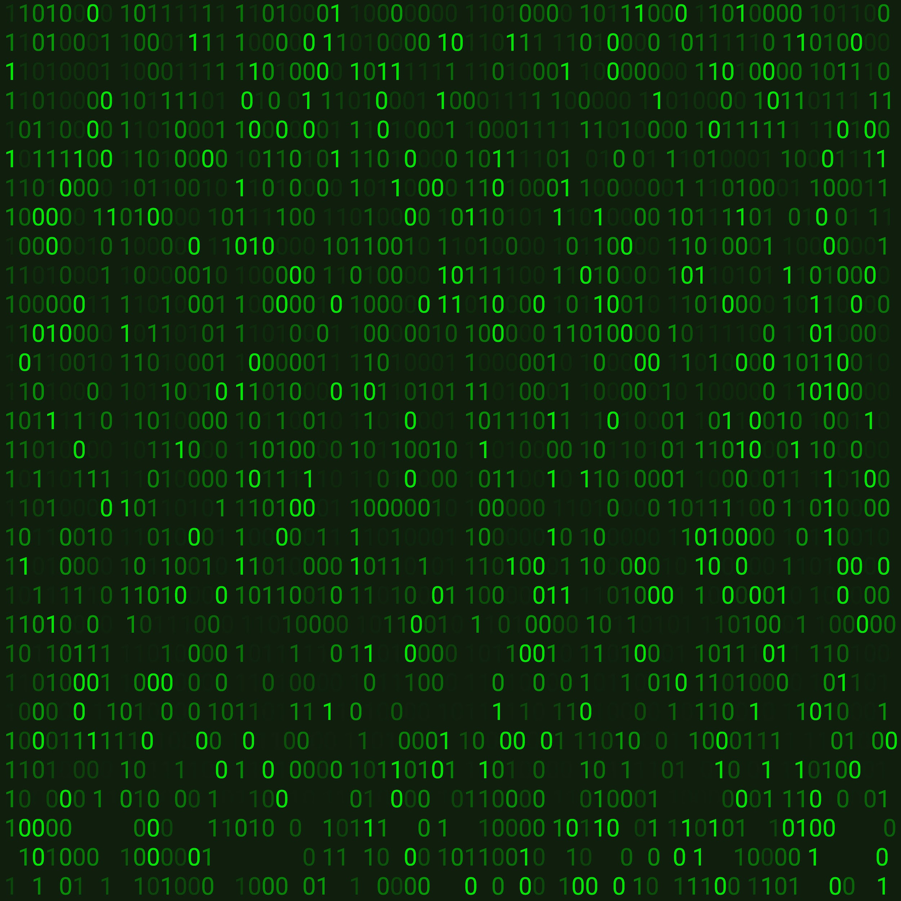
Conversion Table
1024 Bytes | = 1 Kilobyte (KB)
1024 KB | = 1 Megabyte (MB)
1024 MB | = 1 Gigabyte (GB)
1024 GB | = 1 Terabyte (TB)
1 Millihertz | = 0.001 cycles per second
1 hertz(Hz) | = 1 cycle per second
1 Kilohertz | = 1,000 cycles per second
1 Megahertz | = 1 million cycles per second
1 Gigahertz | = 1 billion cycles per second
Notes:
For the conversions, there are different tables for bytes and Hertz, because bytes are based on the power of 2 and cannot be fit into a thousand equally, while Hertz are based on the power of 10.
Bytes represent data transfer rate, while Hertz represents hardware speed

Slide 5


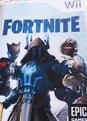

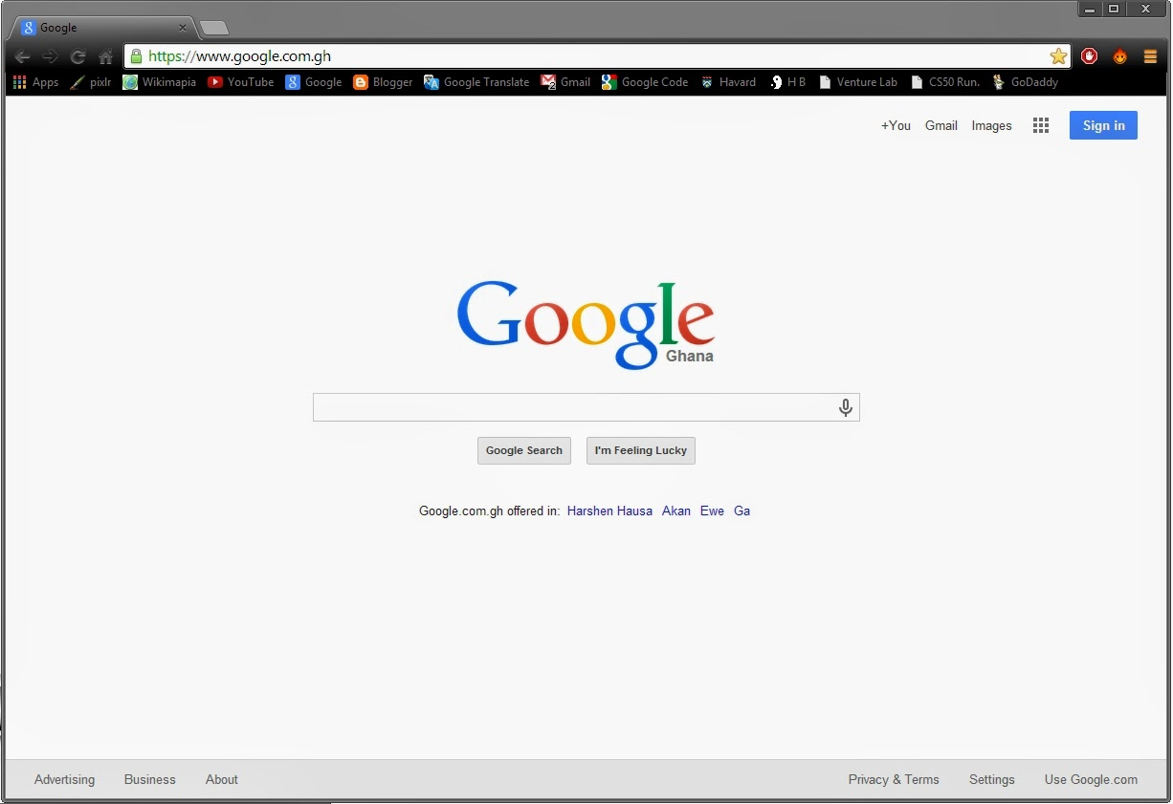
Software
Programs that make use of the hardware.
OS
BIOS
Applications:
Video Games
Editing Tools
Web browsers
And many more!

Slide 6
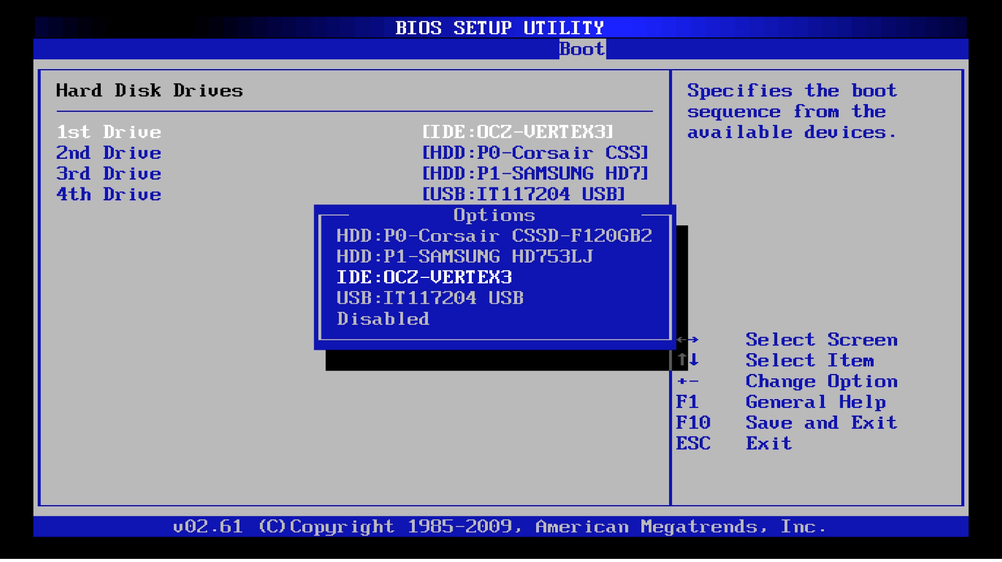
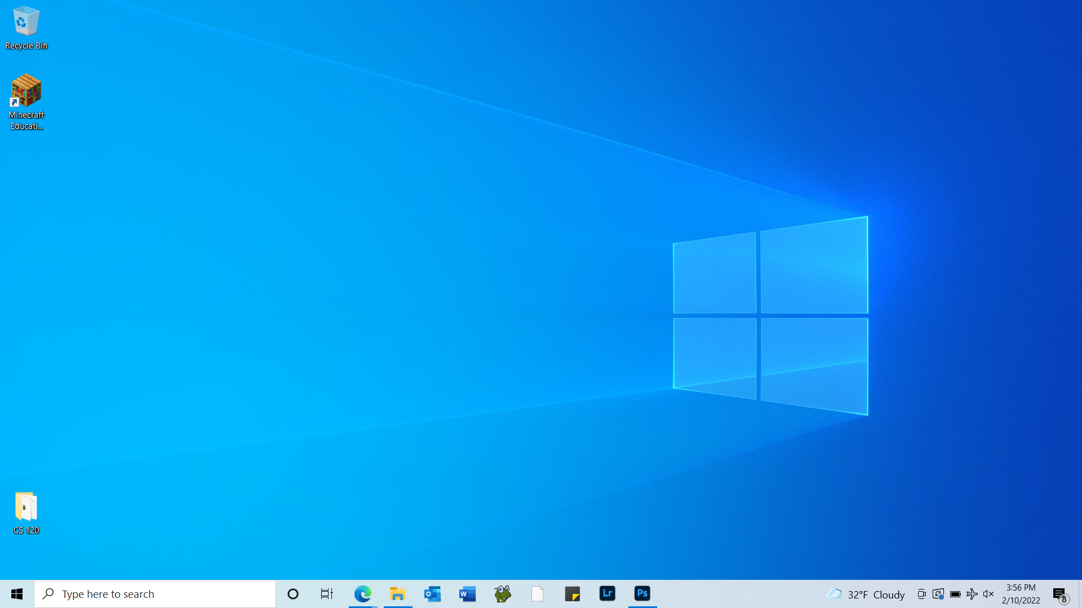
BIOS and OS
BIOS (Basic Input Output System):
Instructions for loading basic hardware
Checks for missing/damaged hardware
Checks OS settings
Analogy: “TSA pre-flight check”
OS (Operating System):
Receives and interprets instructions from software to be performed by hardware
Ex: Windows, MacOS, Linux
Notes:
The BIOS can be thought of as the TSA or a pre-flight check because it makes sure everything is safe and ready to go prior to “take-off” = booting into the OS.

Slide 7
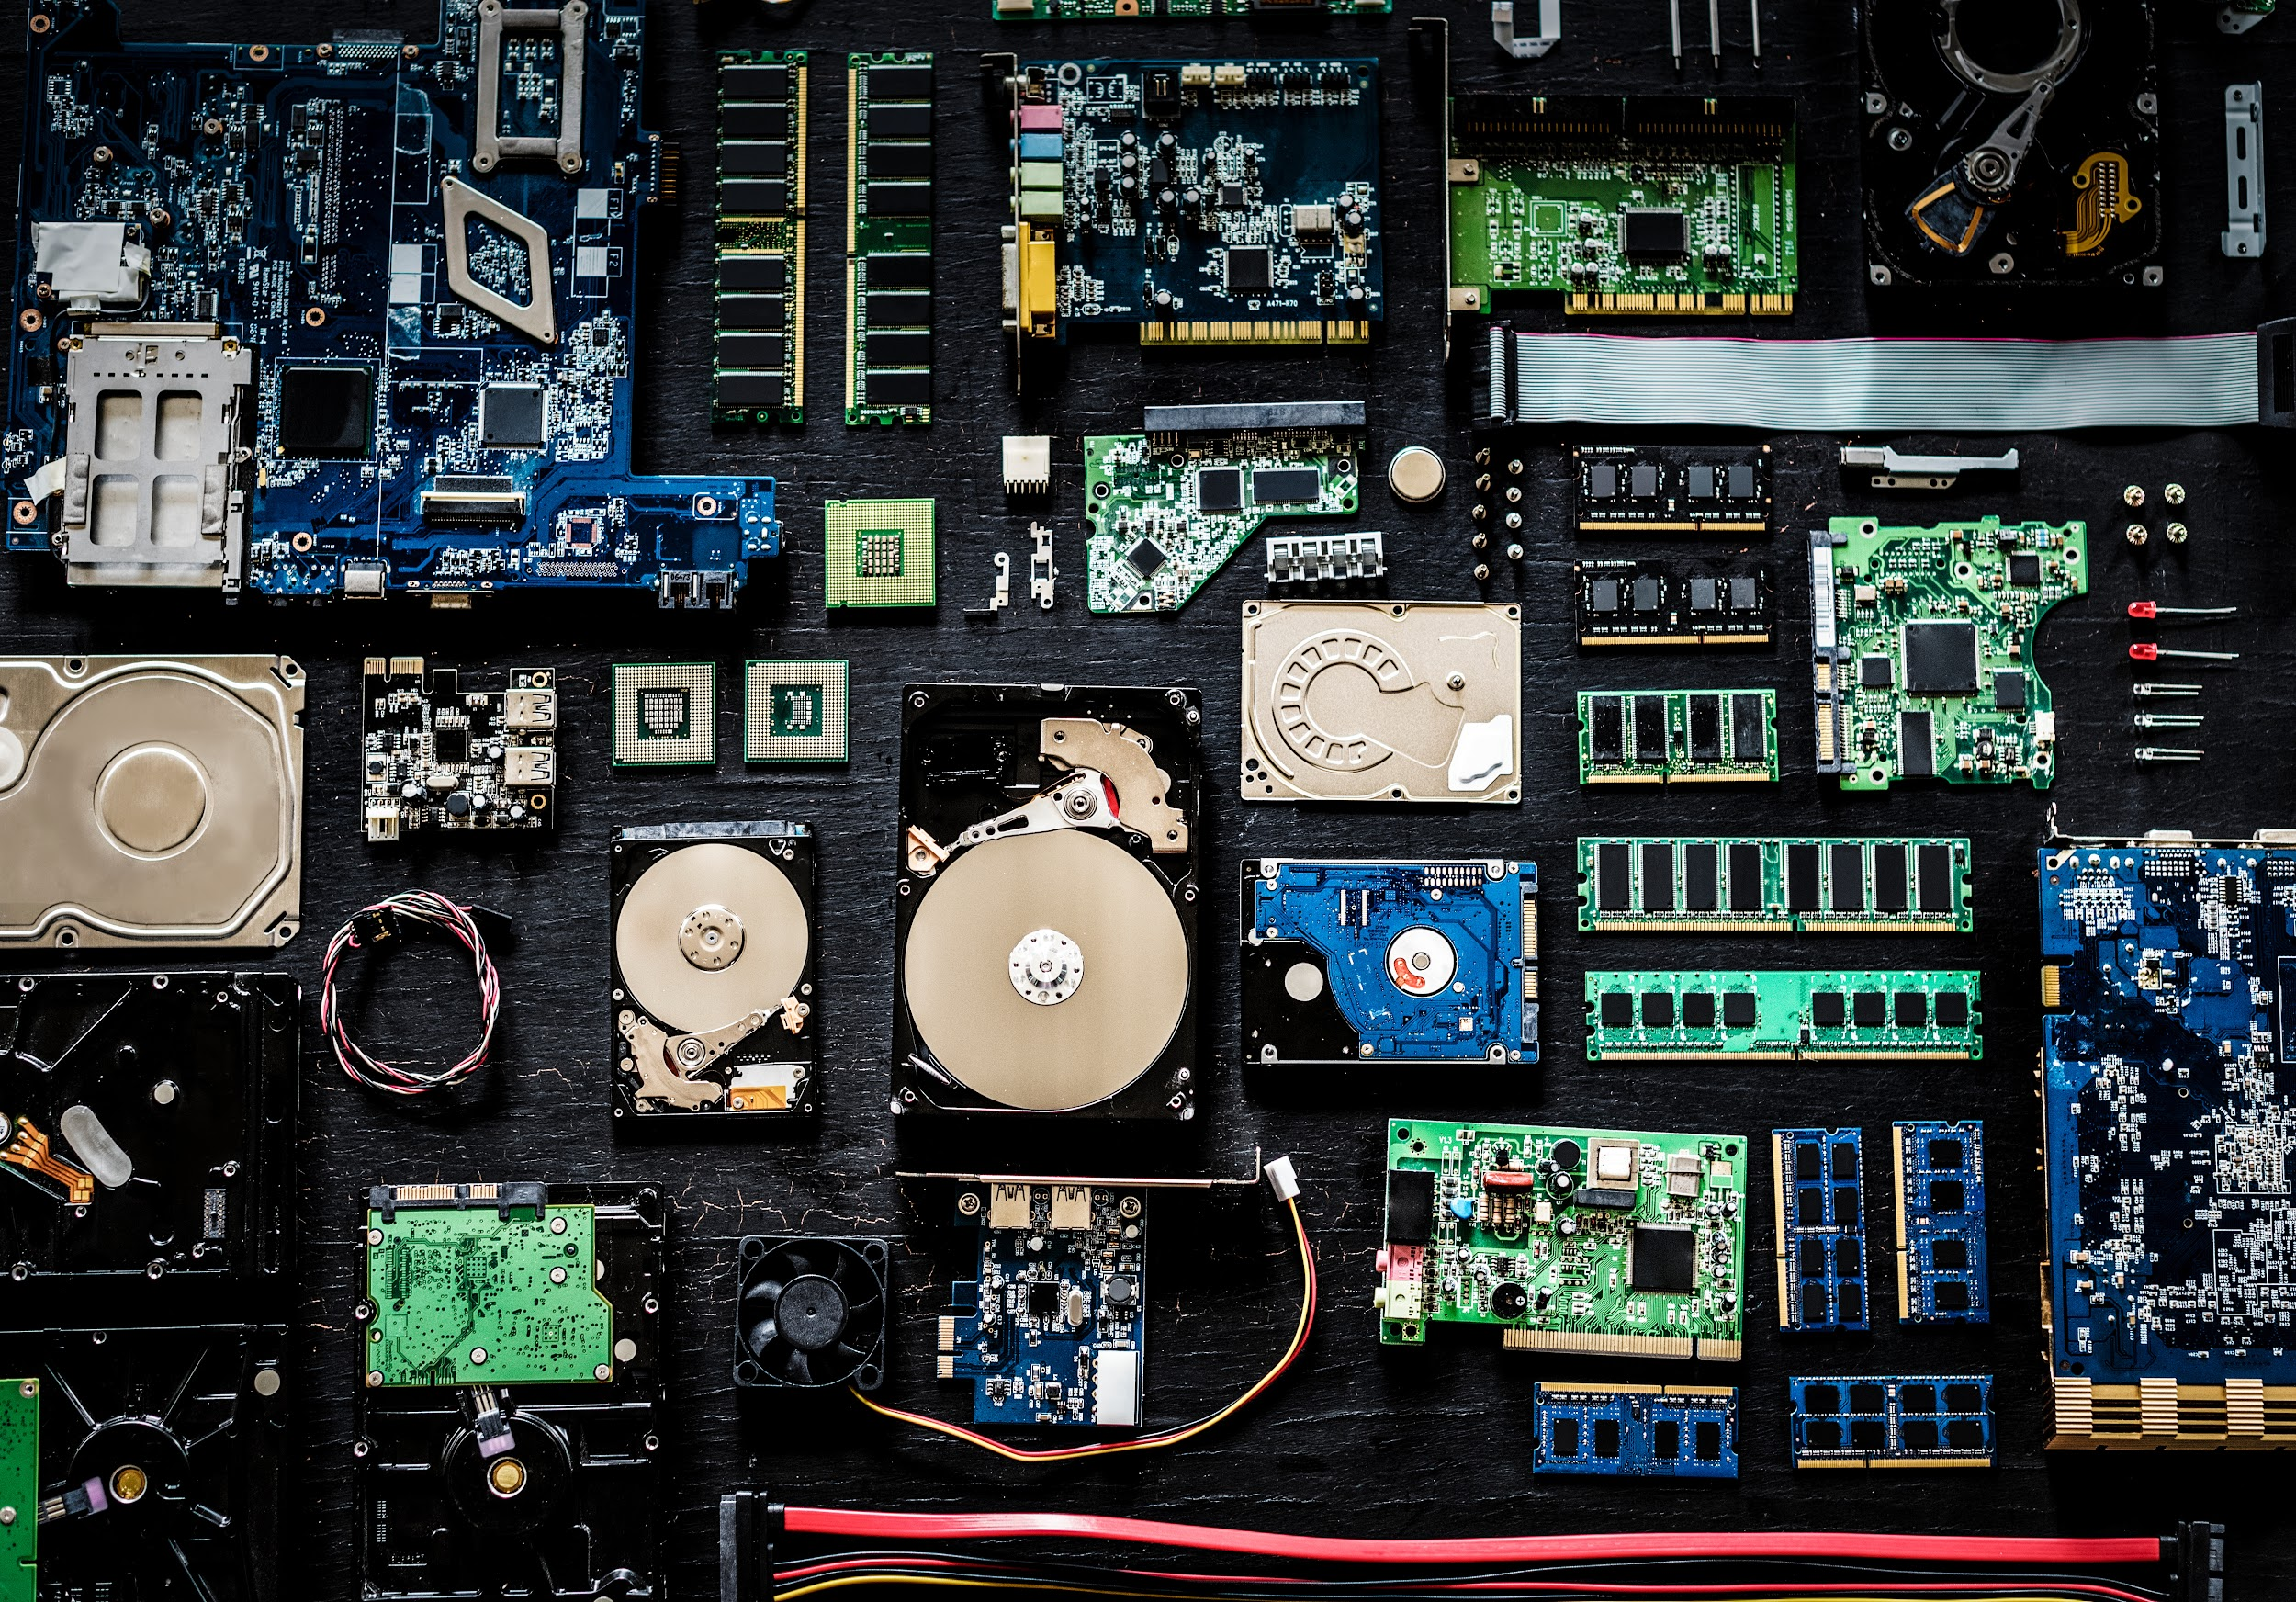
Hardware
The physical components of a computer:
RAM
CPU
GPU
Motherboard
Hard Drive/SSD

Slide 8
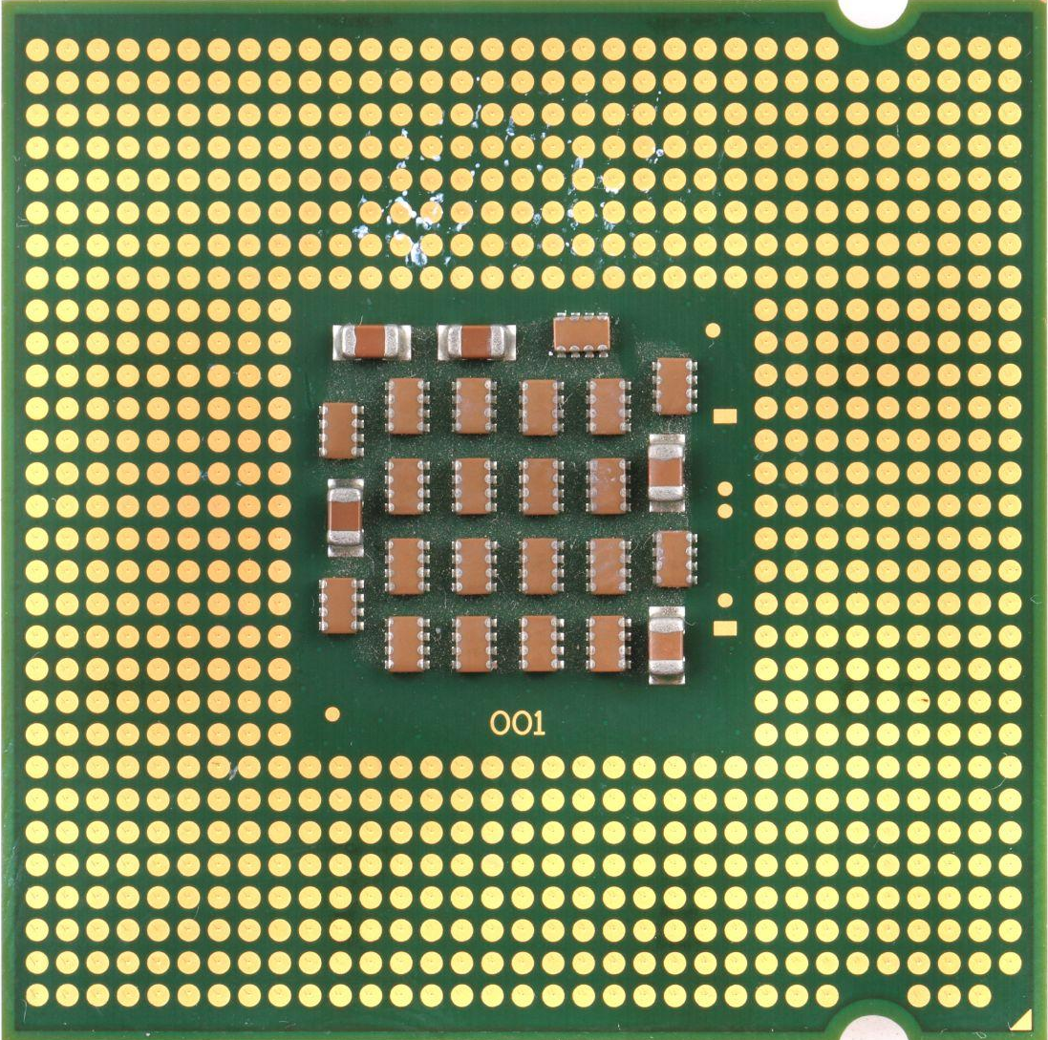
CPU (Central Processing Unit)
Executes instructions provided by software, such as OS and Apps
Multitasking ability
Processes data
CPU speed measured in Hertz (3.5 - 4.2 GHz for a modern CPU)
Equivalent to:
Brain of a human
Notes:
The CPU can be thought of as a brain because it does the “thinking” of the computer like your brain.

Slide 9
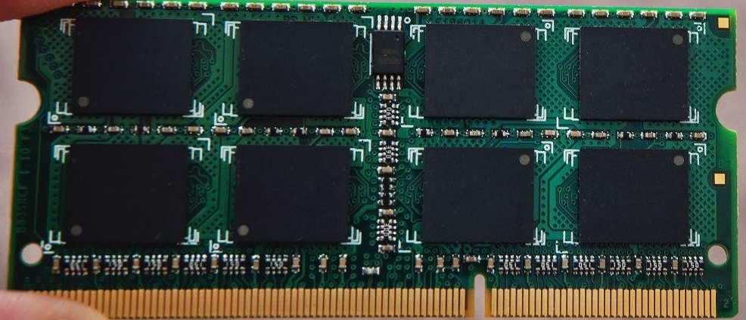
RAM (Random Access Memory)
Short-term memory for computers
Loses information after computer is shut off
Retrieves information on the hard drive to be processed
Measured in Hz (usually between 2400 MHz and 3600MHz)
Equivalent to:
Your short-term memory
Piece of scratch paper for drafting ideas
Notes:
Scratch paper is used to jot down temporary ideas. Scratch paper is thrown away after the information is no longer needed. (Memory is not stored in the RAM after the computer is turned off.)

Slide 10
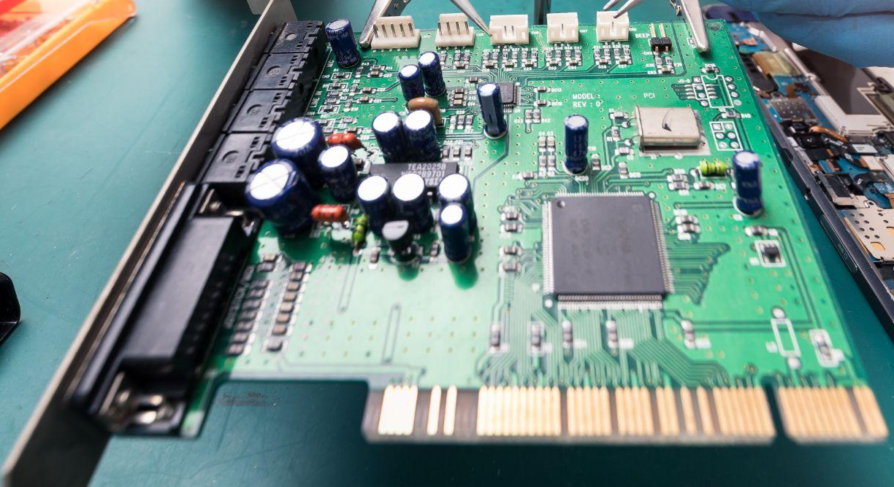
Motherboard
Connects all hardware components together
All components communicate to one another through the motherboard
Pre-installed with BIOS
Equivalent to:
Nervous System
Hallways in a school
Notes:
Motherboard physically connects all of the other computer hardware together, and allows them to interact with each other. The nervous system connects all parts of the body so they can work together. The hallways of a school connect each classroom(and students) together.

Slide 11
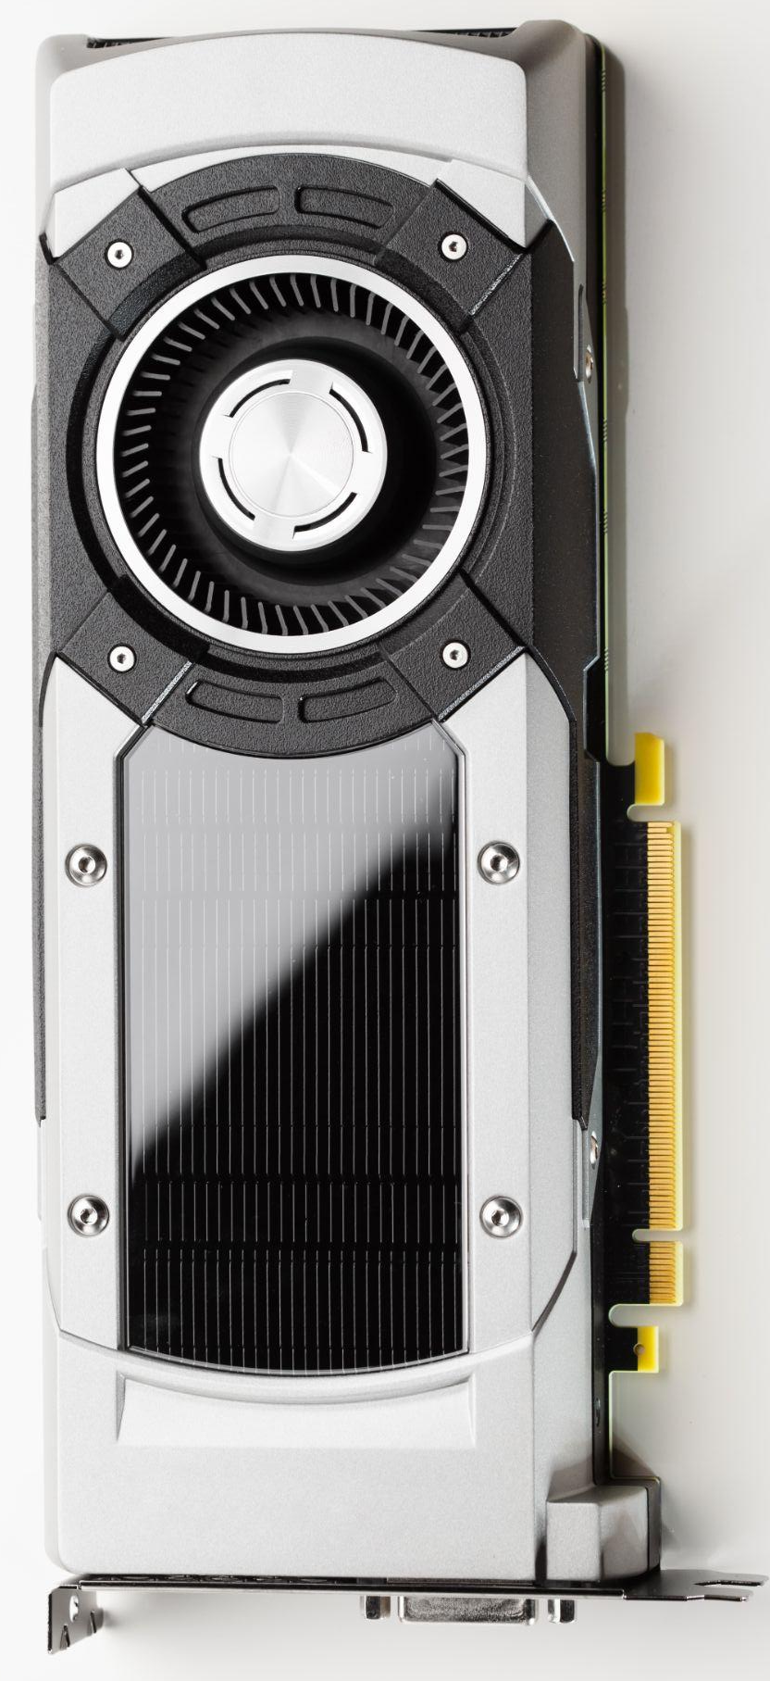
GPU (Graphics Processing Unit)
Similar to the CPU, but breaks tasks down into smaller parts
Computes many pixels at once to display images
Computes 3D shapes
Equivalent to:
Visual sight/Brain comprehending the information from your eyes
Notes:
The primary purpose of a GPU is to render complex shapes and images, commonly for games. When you see an unfamiliar sight, your brain attempts to break it down into more familiar, smaller parts. The GPU breaks down complex visual tasks into smaller parts.

Slide 12
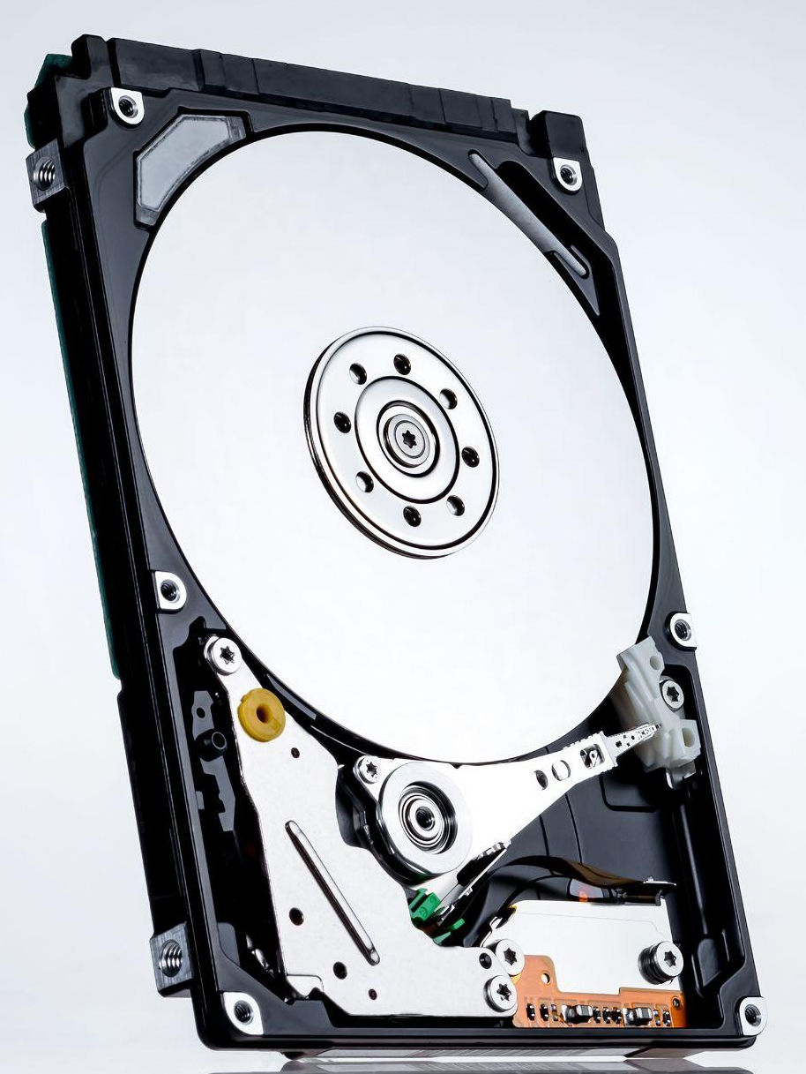
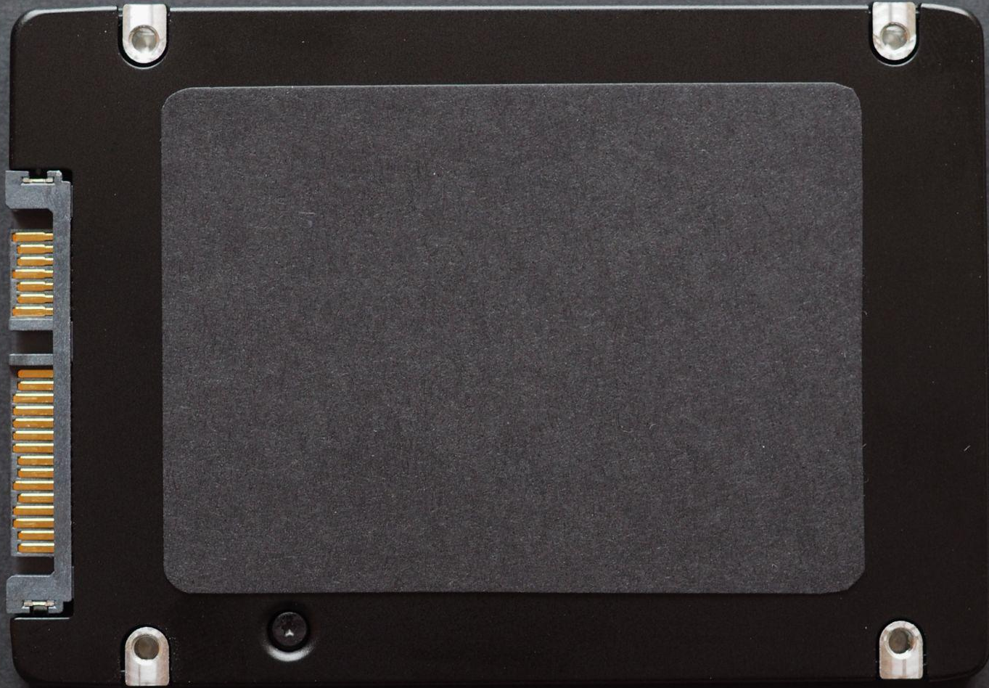
Storage
Hard Disk Drive (HDD)
Disc holding information with magnetism that physically spins
Retains information even when shut off
Solid State Drive (SSD)
Non-volatile flash storage
No moving parts, can run much faster than HDD
HDD and SSD equivalent to “Long-Term Memory”
Equivalent to:
Library in a school
Notes:
Both HDDs and SSDs retain the data while not powered. This is similar to a school’s library because all of the books and stored knowledge still exists when no one is in the library.

